Slide 1
Data Spaces: the EC solution for environmental, biodiversity and climate challenges.
Different approaches on multisource data, semantics, FAIRness and sovereignty
2024-10-02 - 16:30
Maria Theresia Seminar room (Conference Center Laxenburg)

Slide 2
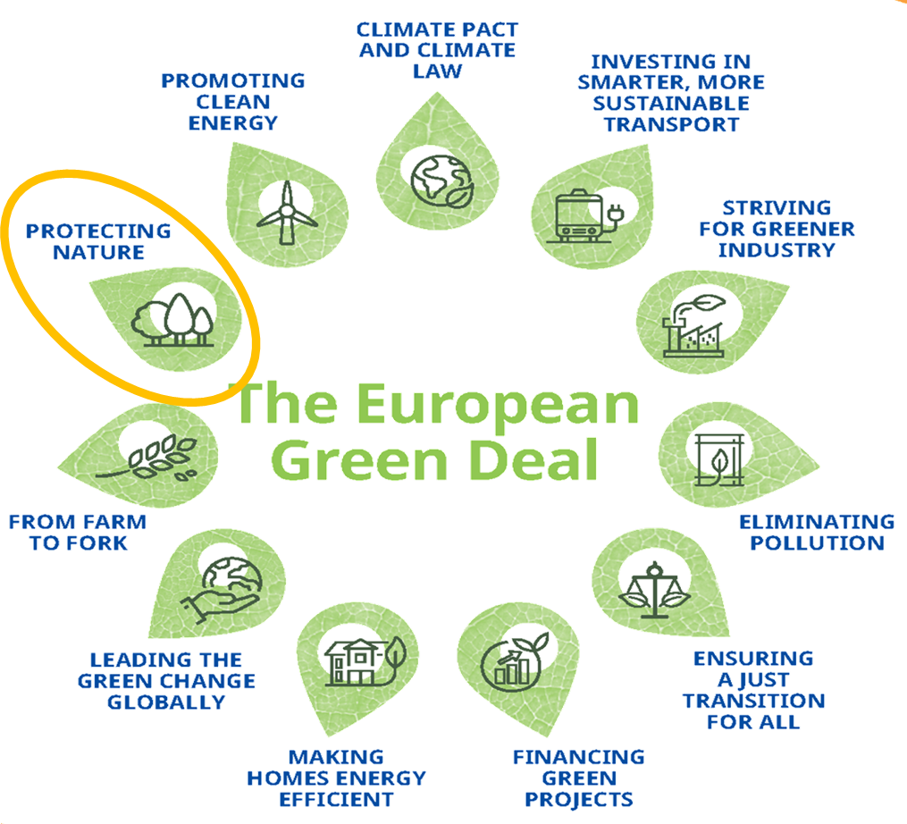
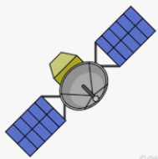
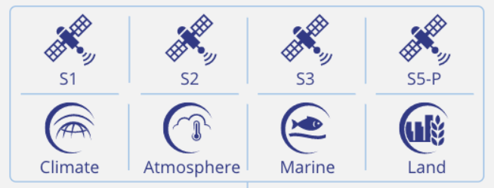
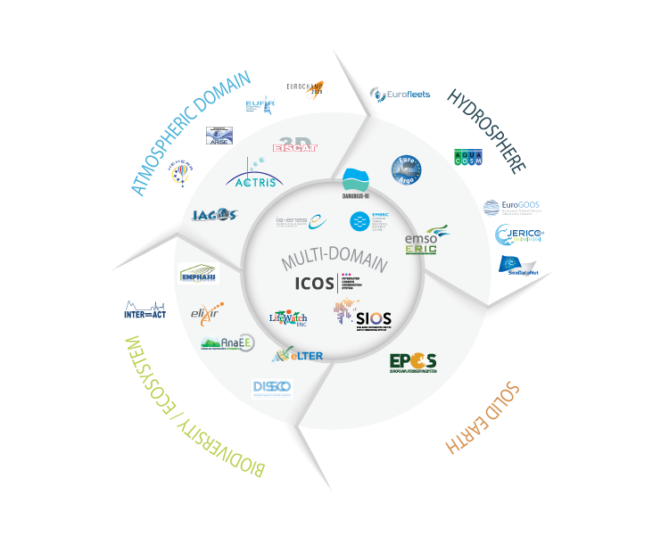
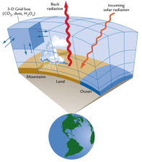
Data Spaces: the EC solution for environmental, biodiversity and climate challenges.
Action Group on the Green Deal Data Space
Data Spaces
A Data Space is an infrastructure that enables data exchange based on:
Trusted and secure trading of data assets with automated and robust controls on legal compliance and remuneration.
Compliance with regulations for personal data is ensured.
Green Deal Data Space (GDDS)
The Green Deal Data Space is the EC solution to support implementing Green Deal policies with relevant data (on air, water, soil quality with regard to the zero-pollution strategy) and contribute to better environmental transparency and better decision-making.
Data multisource for the GDDS
2

Slide 3
Data Spaces: the EC solution for environmental, biodiversity and climate challenges.
Action Group on the Green Deal Data Space
Challenges for the Green Deal Data Space
Semantic interoperability
Metadata dynamic & automatic documentation (STAC, GeoNetwork, etc.)
Multisource Data Integration
Dynamic multidimensional data cubes
Sensor and IoT data: integration, standard documentation, extraction, etc.
Integrate APIs implementations with data space connectors
Standard data queries: OGC APIs, openeo, CQL, etc.
Authentication & Privacy of data (OAuth, etc.)
Geospatial User Feedback
Others…
3

Slide 4
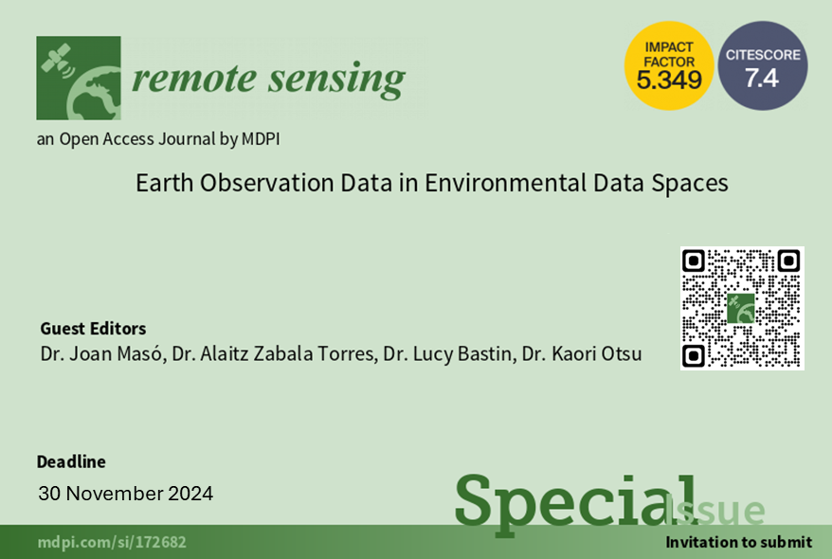
Data Spaces: the EC solution for environmental, biodiversity and climate challenges.
Action Group on the Green Deal Data Space

Slide 5
Data Spaces: the EC solution for environmental, biodiversity and climate challenges.
Action Group on the Green Deal Data Space
Participants:
AD4GD: Joan Masó (joan.maso@uab.cat)
FairiCube: Kathi Schleidt (kathi@datacove.eu)
USAGE: Giacomo Martirano (g.martirano@epsilon-italia.it)
OEMC: Milutin Milenkovic (milenkovic@iiasa.ac.at)
All: open discussions
5

Slide 6
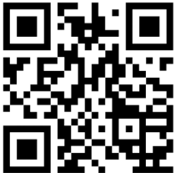
Thank you!
https://actiongroup.greendealdata.space/
Action Group on the Green Deal Data Space
Get our newsletter!
Organized by:
www.ad4gd.eu
Twitter: @ad4gd_project
LinkedIn: AD4GD Project
6
eepurl.com/iz6mDY

