Slide 1
Data Spaces: the EC solution for environmental, biodiversity and climate challenges.
Different approaches on multisource data, semantics, FAIRness and sovereignty
2024-10-02 - 16:30
Maria Theresia Seminar room (Conference Center Laxenburg)
Kathi Schleidt
DataCove e.U.

Slide 2
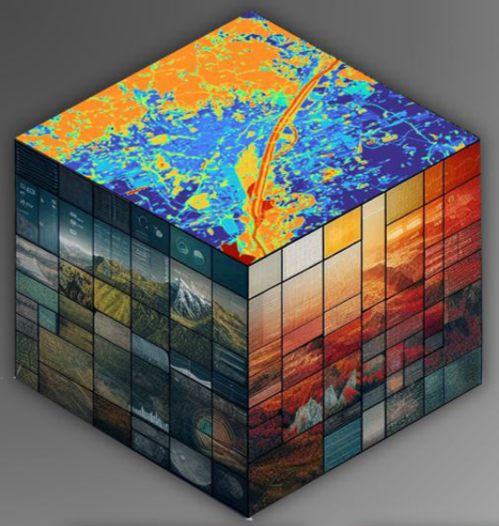
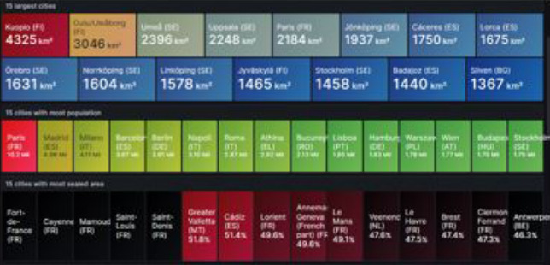
FAIRiCUBE: enabling players from beyond classic EO domains to provide, access, process, and share gridded data and algorithms in a FAIR and TRUSTable manner.
Action Group on the Green Deal Data Space
Diverse
Technologies
5 Use Cases
Funded by EU Horizon 2020
Call: HORIZON-CL6-2021-GOVERNANCE-01-17
Project No: 101059238
EU contribution: € 3,202,843.75
Duration: 2022 – 2025 (36 months)
8 Partners
2

Slide 3
FAIRiCUBE: Requirements to GDDS
Action Group on the Green Deal Data Space
Metadata
Tailored to satellite data, lacking for terrestrial products
Alignment of diverse standards:
ISO 19115
STAC
GeoDCAT
Data Access
Deficits identified in old OGC Web Services
Focus on APIs:
OGC API – Coverage
OGC Environmental Data Retrieval API
openEO
Concepts and Vocabularies
Essential for interoperability
Underlying conceptual models enable harmonization
Rich vocabularies (e.g. Observable Properties via I-ADOPT) enrich semantics
Analysis and Processing
Potential of ML/AI breathtaking
Unclear how dependable outputs are
Support required in estimating resource usage
3

Slide 4
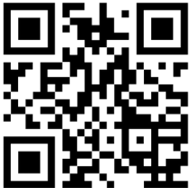
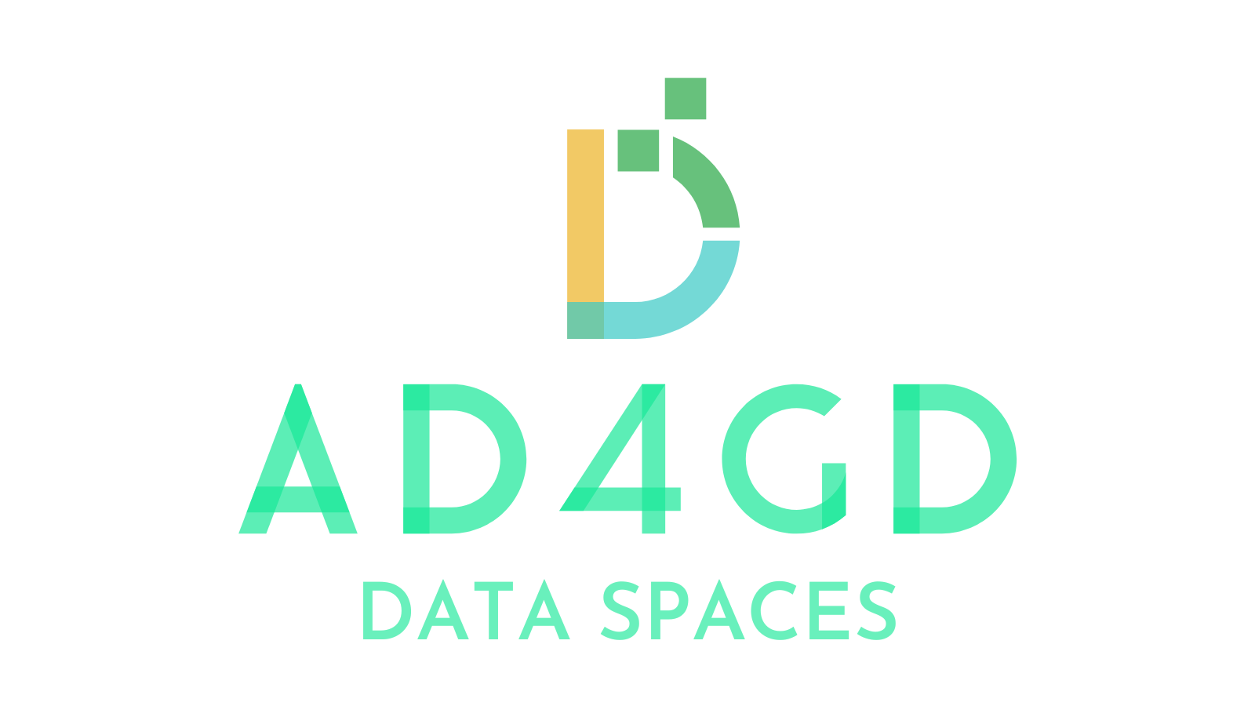
Thank you!
https://actiongroup.greendealdata.space/
Action Group on the Green Deal Data Space
www.FAIRiCUBE.eu
Get our newsletter!
Organized by:
www.ad4gd.eu
Twitter: @ad4gd_project
LinkedIn: AD4GD Project
4
eepurl.com/iz6mDY

