Slide 1
Data Spaces: the EC solution for environmental, biodiversity and climate challenges.
Different approaches on multisource data, semantics, FAIRness and sovereignty
2024-10-02 - 16:30
Maria Theresia Seminar room (Conference Center Laxenburg)

Slide 2
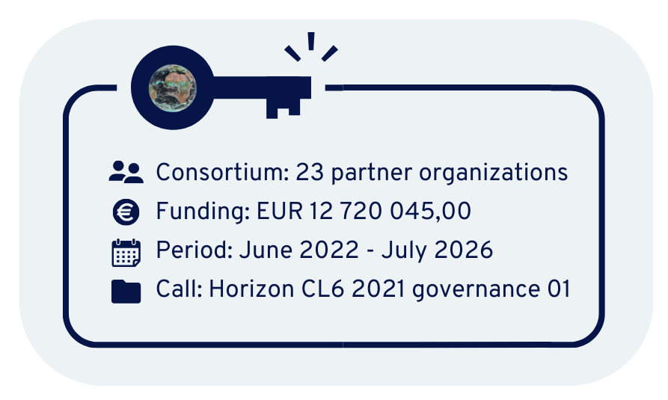
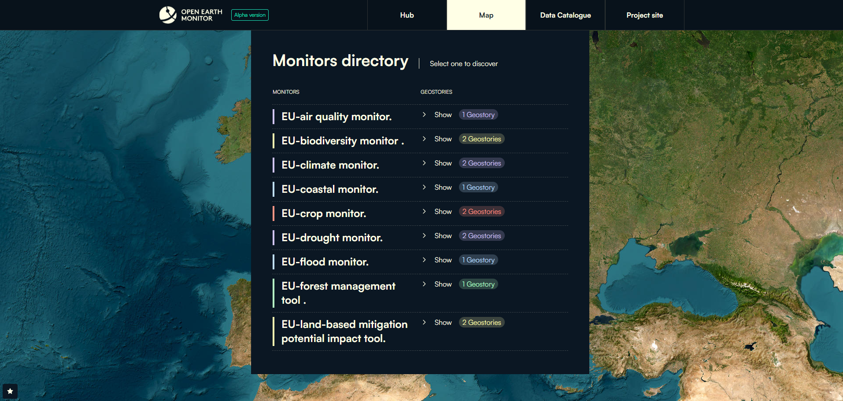
The OEMC Project
Action Group on the Green Deal Data Space
FAIR Science: Findable, Accessible, Interoperable & Reproducible
Reproducible research: computational notebooks, knowledge hubs, …
Open Source software: AGPL, GPL, MIT, Apache, …
Open Data license: CC-BY, CC-BY-SA, ODbL, …
Data & metadata repo’s + catalogs: STAC, Zenodo …
https://app.earthmonitor.org
2

Slide 3
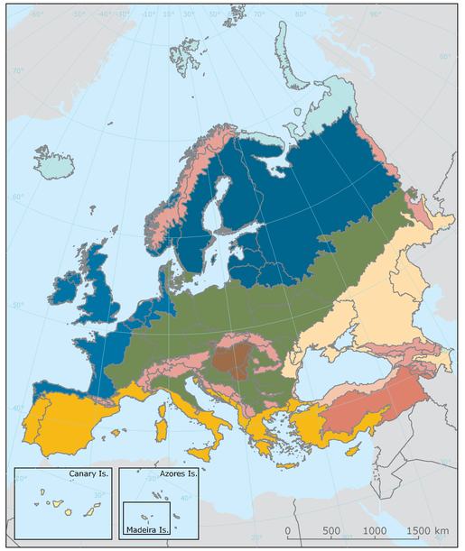
OEMC Geospatial Data Approach
Action Group on the Green Deal Data Space
Survey on FAIR Geospatial Data
114 responses: 72% Users, 28% Producers/Providers
OEMC
OPEN
Cloud-optimized
FAIR
>40% of data producers are NOT familiar with FAIR principles!
OEMC Use Cases & Monitors
Data in Europe
Data Management Plan D1.3
3

Slide 4
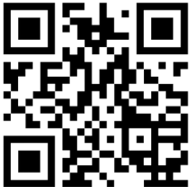
Thank you!
https://actiongroup.greendealdata.space/
Action Group on the Green Deal Data Space
https://earthmonitor.org/
Get our newsletter!
Organized by:
www.ad4gd.eu
Twitter: @ad4gd_project
LinkedIn: AD4GD Project
4
eepurl.com/iz6mDY

