Slide 1
Data Spaces: the EC solution for environmental, biodiversity and climate challenges.
Different approaches on multisource data, semantics, FAIRness and sovereignty
2024-10-02 - 16:30
Maria Theresia Seminar room (Conference Center Laxenburg)

Slide 2
Data Spaces: the EC solution for environmental, biodiversity and climate challenges.
Action Group on the Green Deal Data Space
Facts and figures:
4 prototype urban data spaces being implemented in 4 pilot cities (Ferrara-IT, Zaragoza-ES, Graz-AT, Leuven-BE)
11 use cases addressing 3 European Green Deal policy areas covered by Local Green Deal/City Contracts
A policy-driven use case conceptual model
BPMN representation of the use cases
A GeoNetwork-based catalogue (https://usage.geocat.live/) currently publishing 347 datasets metadata and 48 tools&algorithms metadata:
harvesting existing CKAN open data catalogues
allowing editing of new metadata using ISO 19115 based templates
adopting a procedure to document in the lineage field semantic and syntactic requirements for new datasets
Semantic harmonisation of Decision Ready Information (use case output datasets) based on extension/flattening of INSPIRE data models
A use case focused validation approach for a data space
A data space validation dashboard
On-going mapping of 4 prototype data spaces toward technical and business & organisational Building Blocks of DSSC Blueprint v1.0
2

Slide 3
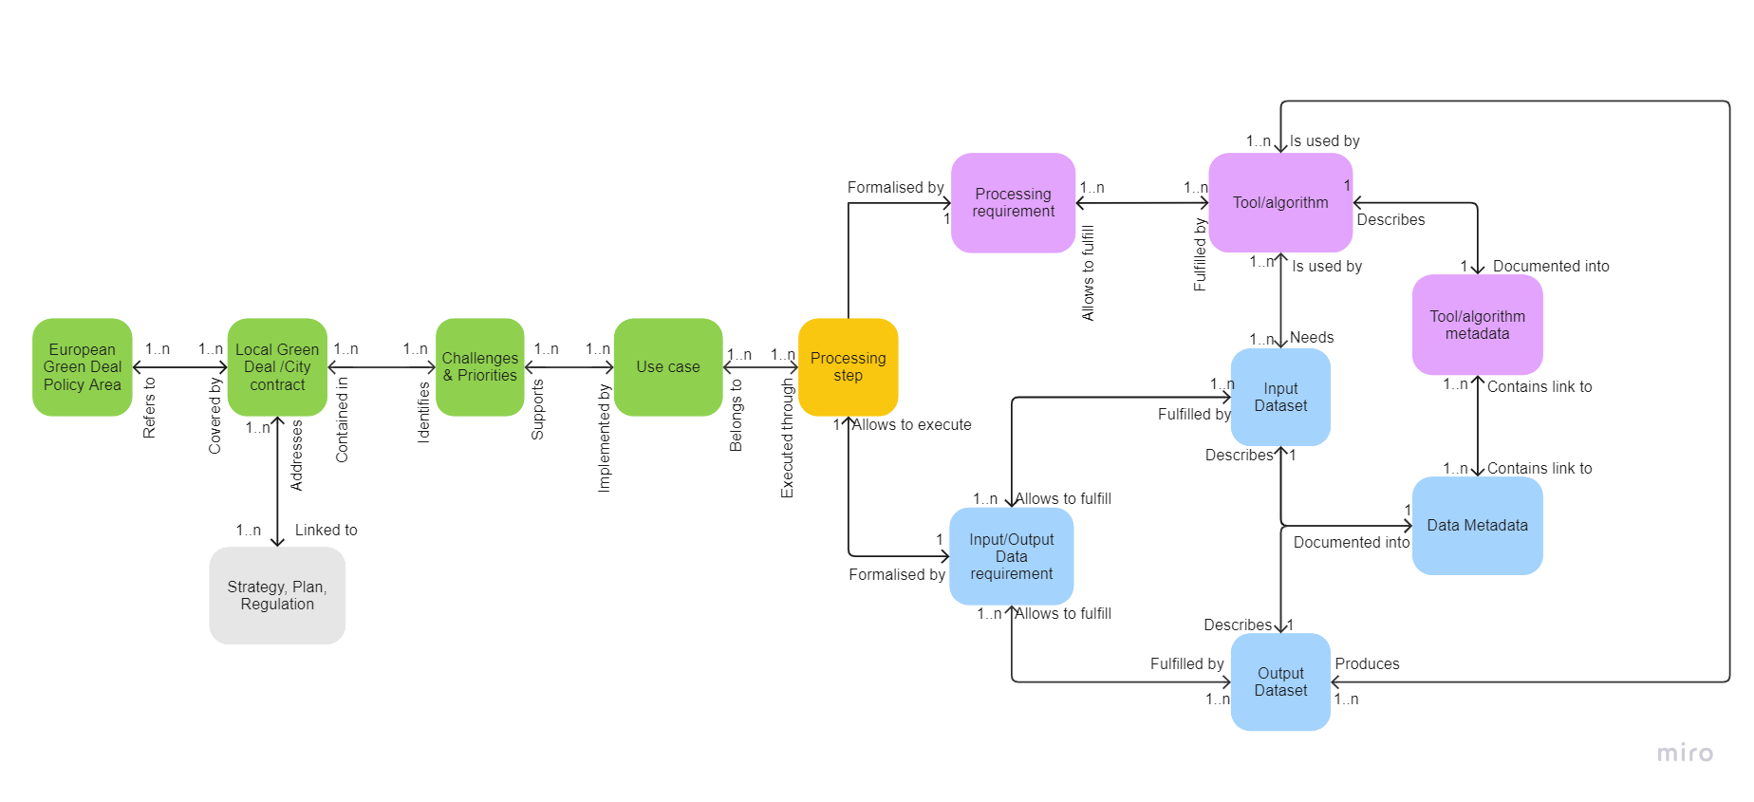
Data Spaces: the EC solution for environmental, biodiversity and climate challenges.
Action Group on the Green Deal Data Space
Policy-driven use case conceptual model
3

Slide 4
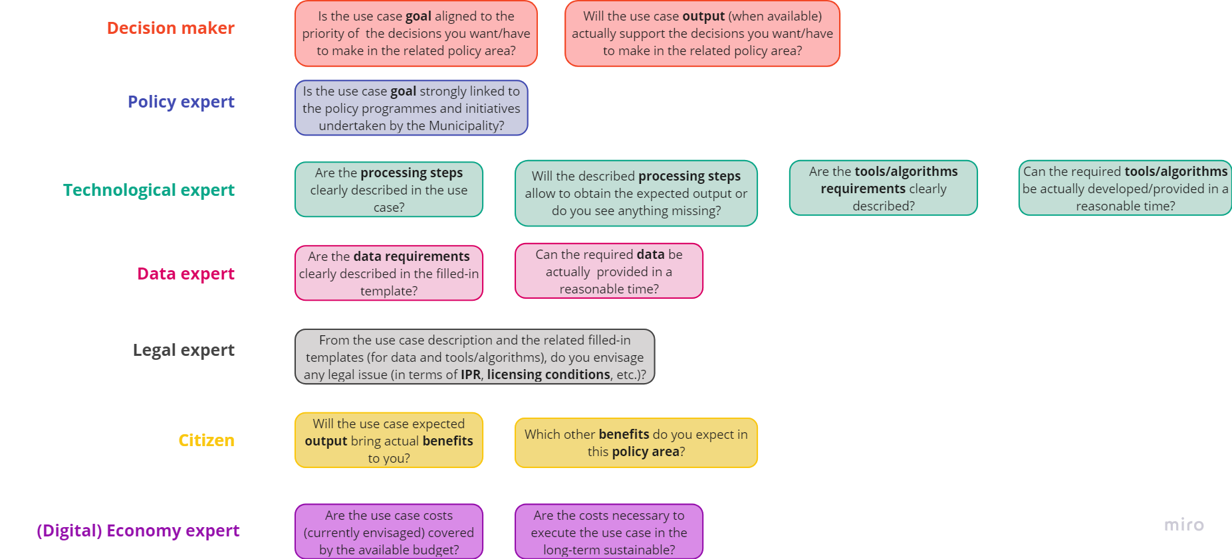
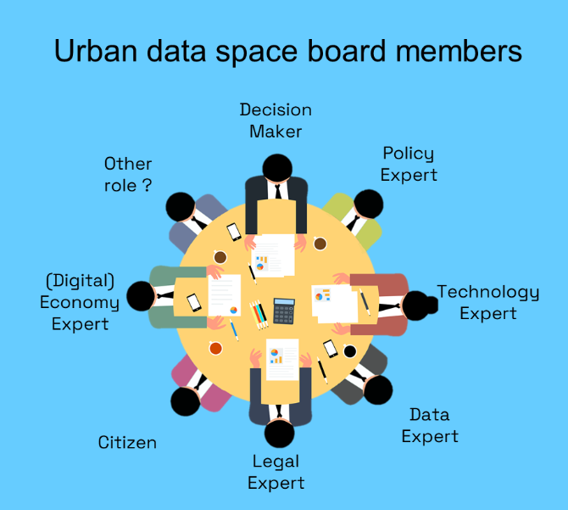
Data Spaces: the EC solution for environmental, biodiversity and climate challenges.
Action Group on the Green Deal Data Space
A use case focused validation approach for a data space
4

Slide 5
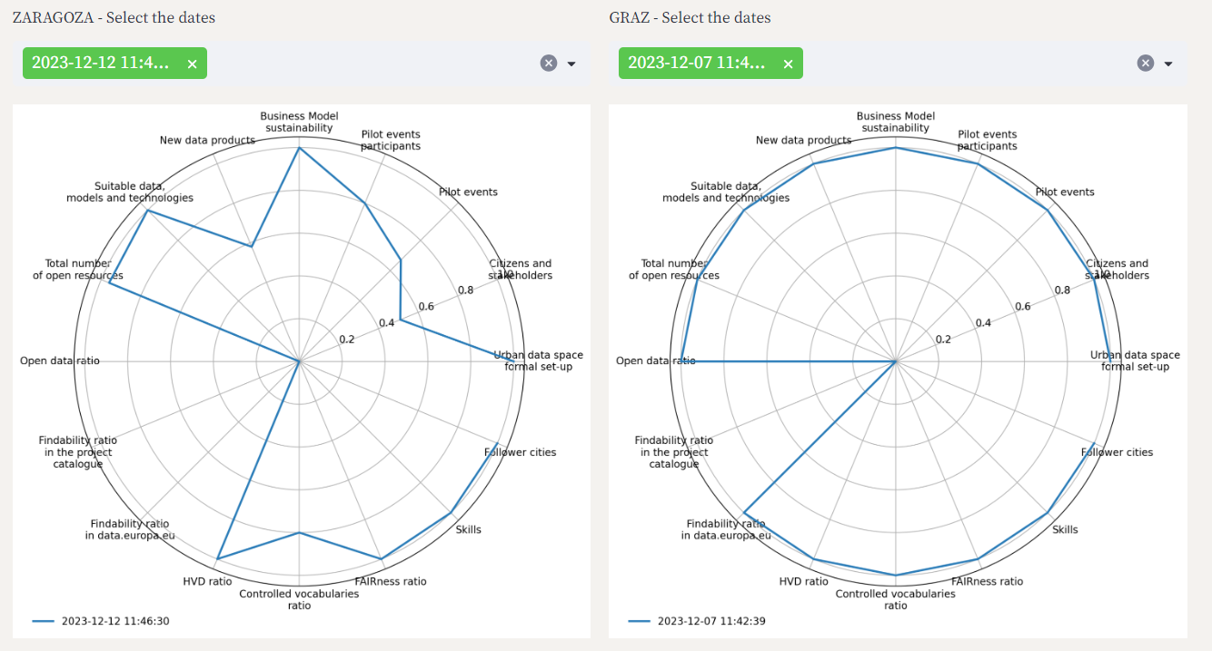
Data Spaces: the EC solution for environmental, biodiversity and climate challenges.
Action Group on the Green Deal Data Space
A data space validation dashboard
5

Slide 6
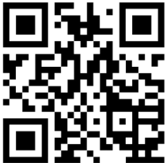
Thank you!
https://actiongroup.greendealdata.space/
Action Group on the Green Deal Data Space
https://www.usage-project.eu/
X: @USAGE_project
https://www.youtube.com/channel/UCk6QgbGuJlyJ5g98DG90tCQ
Get our newsletter!
Organized by:
www.ad4gd.eu
Twitter: @ad4gd_project
LinkedIn: AD4GD Project
6
eepurl.com/iz6mDY

