Slide 1
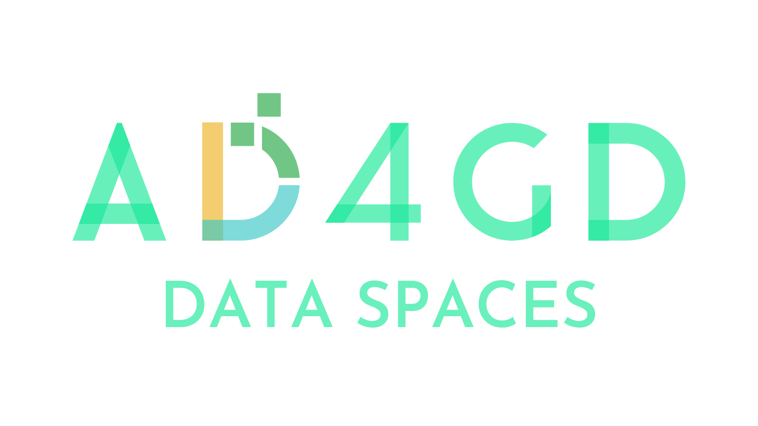
Data Spaces: the EC solution for environmental, biodiversity and climate challenges.
Different approaches on multisource data, semantics, FAIRness and sovereignty
2024-10-02 - 16:30
Maria Theresia Seminar room (Conference Center Laxenburg)

Slide 2
AD4GD contributions to the Green Deal Data Space
Joan Masó
2024-10-02 - 16:30
Maria Theresia Seminar room (Conference Center Laxenburg)

Slide 3
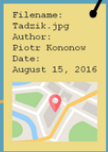
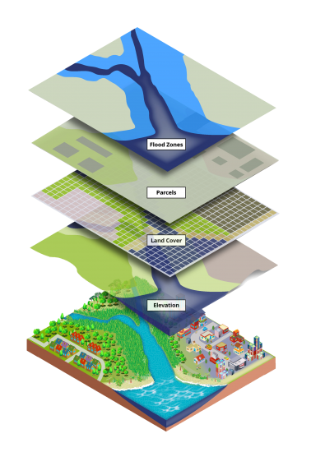
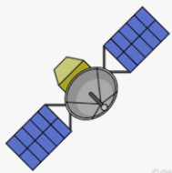
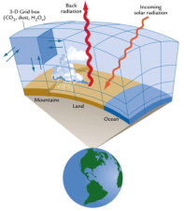
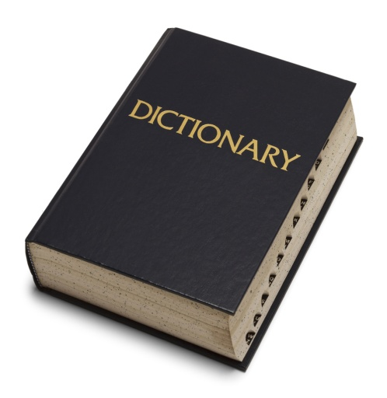
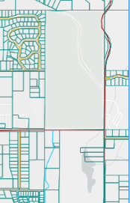
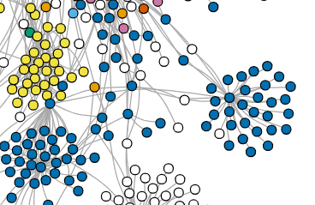
Semantic
tagging
Dimension
definition
GDIM
Original layers are no longer "visible"
DC
Ess. Variables (a.k.a observedProperties) and UoM Vocabularies
t
GDDS
X
Y
RDF
Representation of mainly object based
Features / STAplus / GeoSPARQL queries
DC representation of mainly gridded based
Coverages, Xarray queries
"subLayer" extraction
(a.k.a collections)
Open access
OAuth
Contract validation

Slide 4
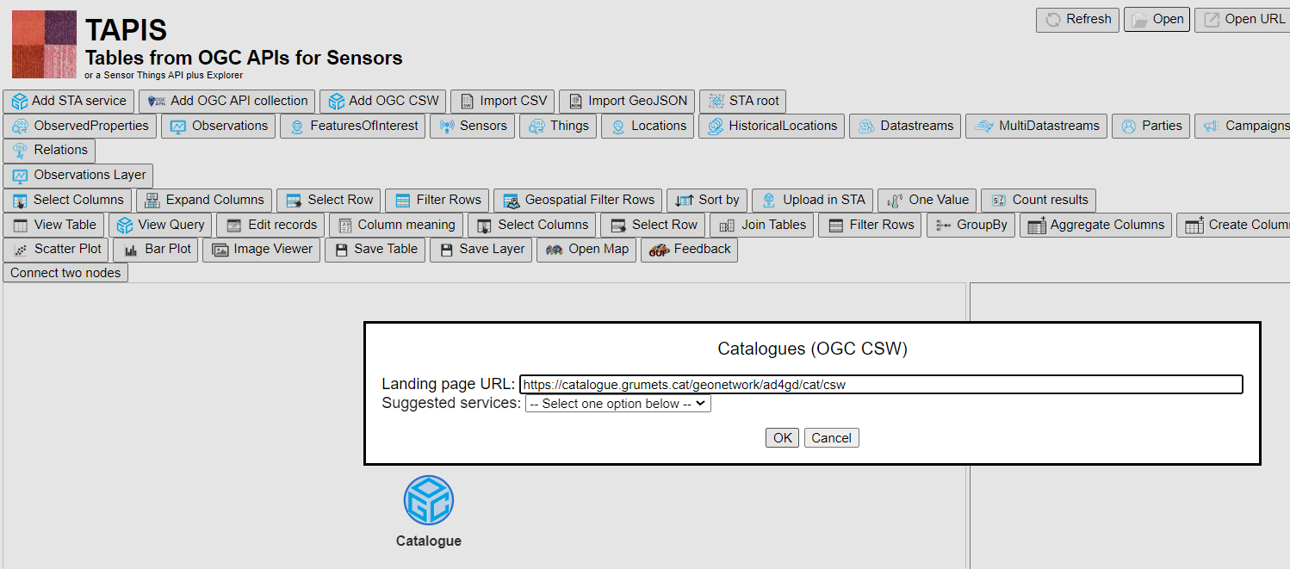
https://github.com/joanma747/TAPIS

Slide 5
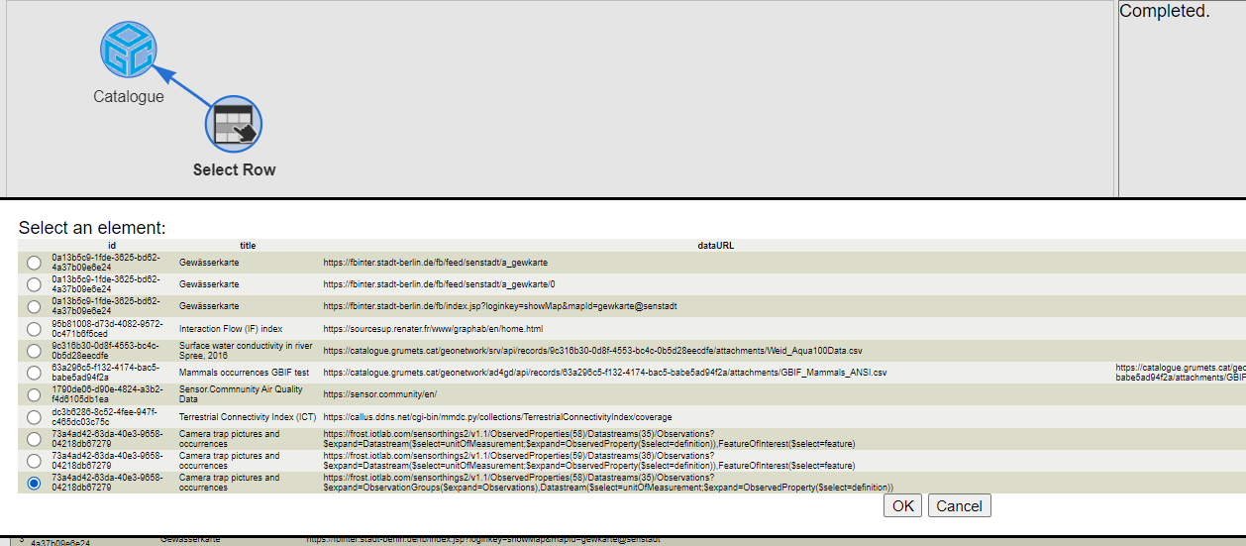

Slide 7
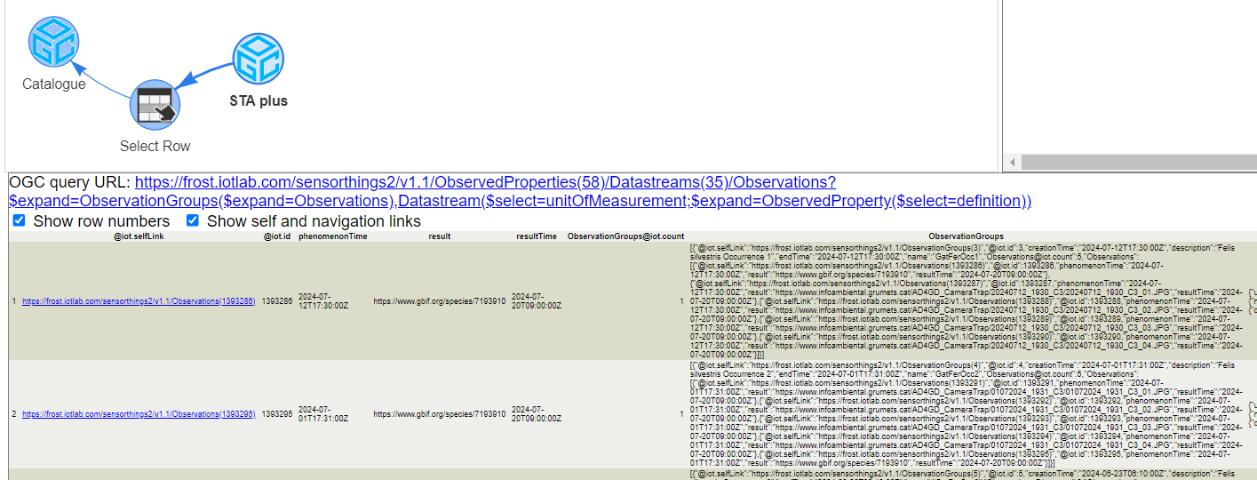

Slide 8
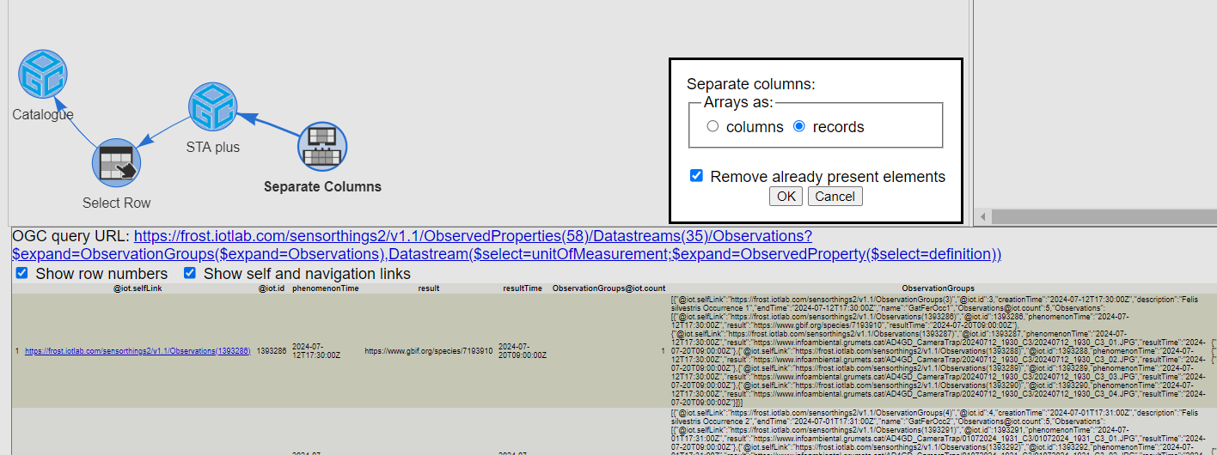

Slide 9
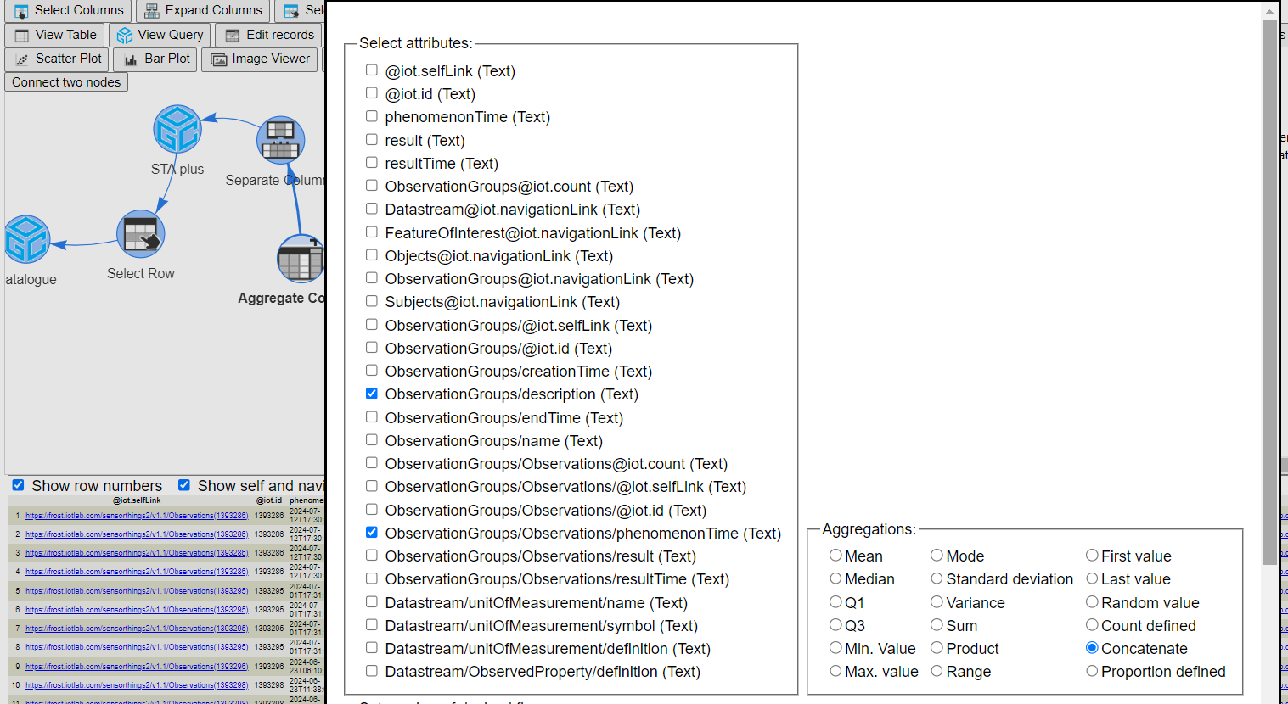

Slide 10
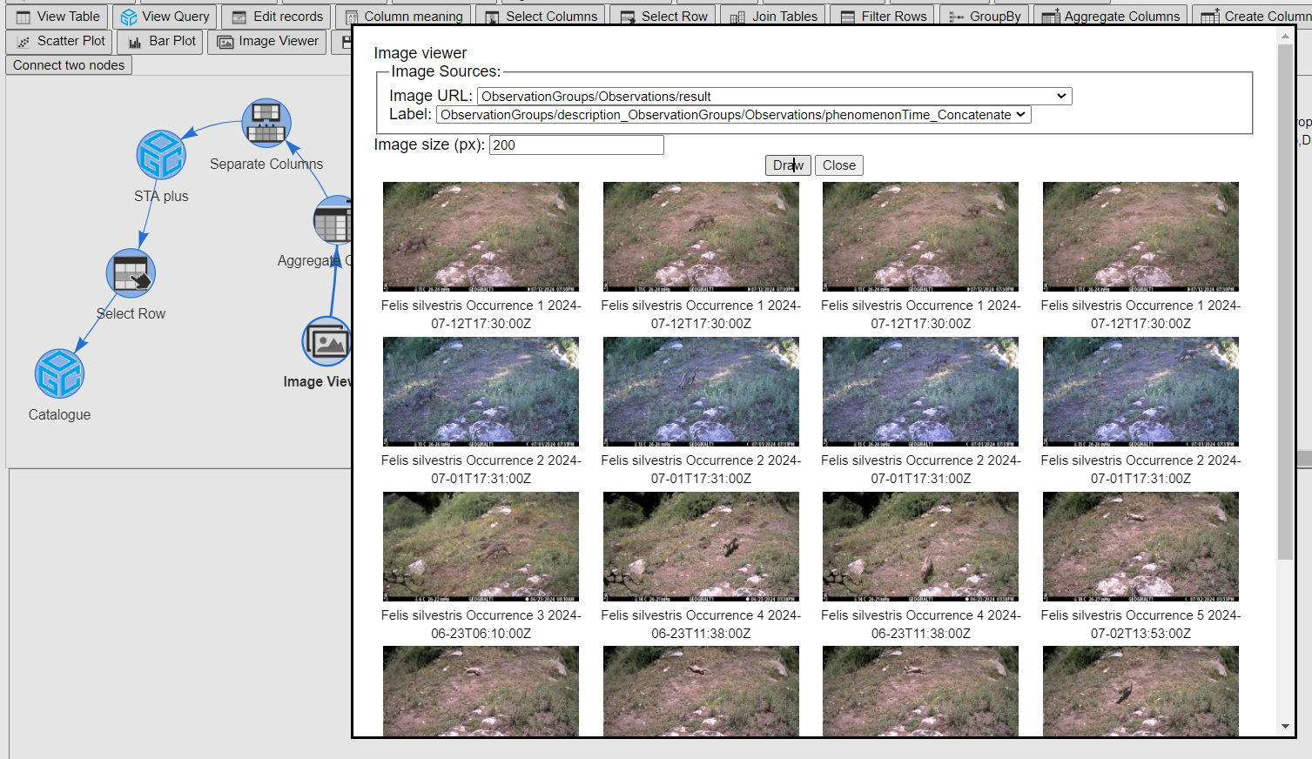

Slide 11
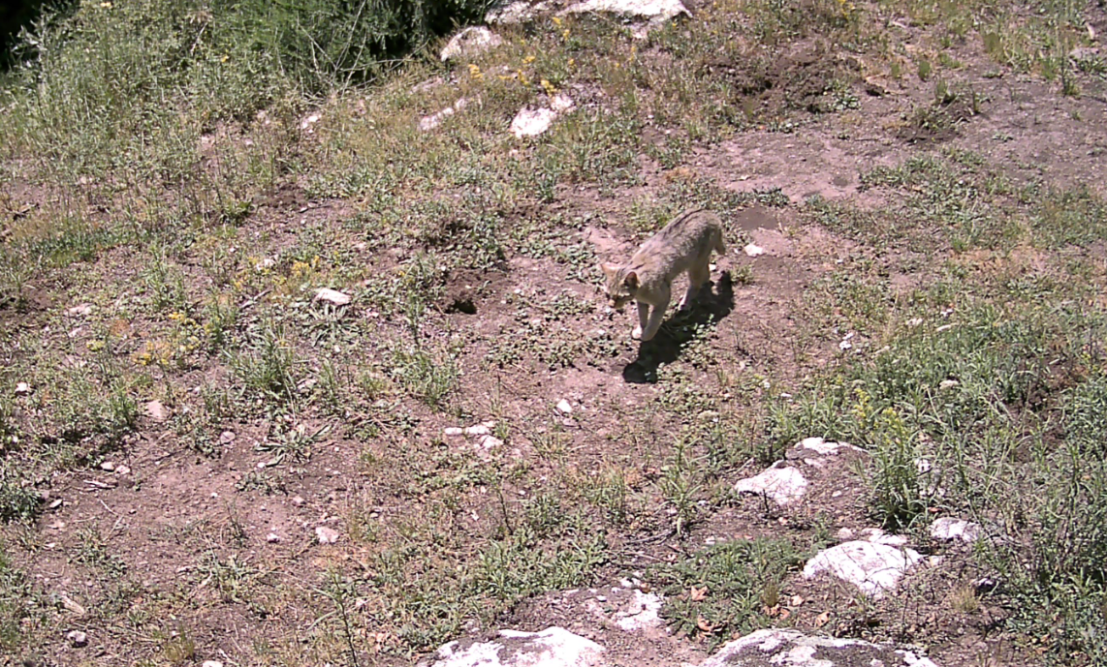

Slide 12
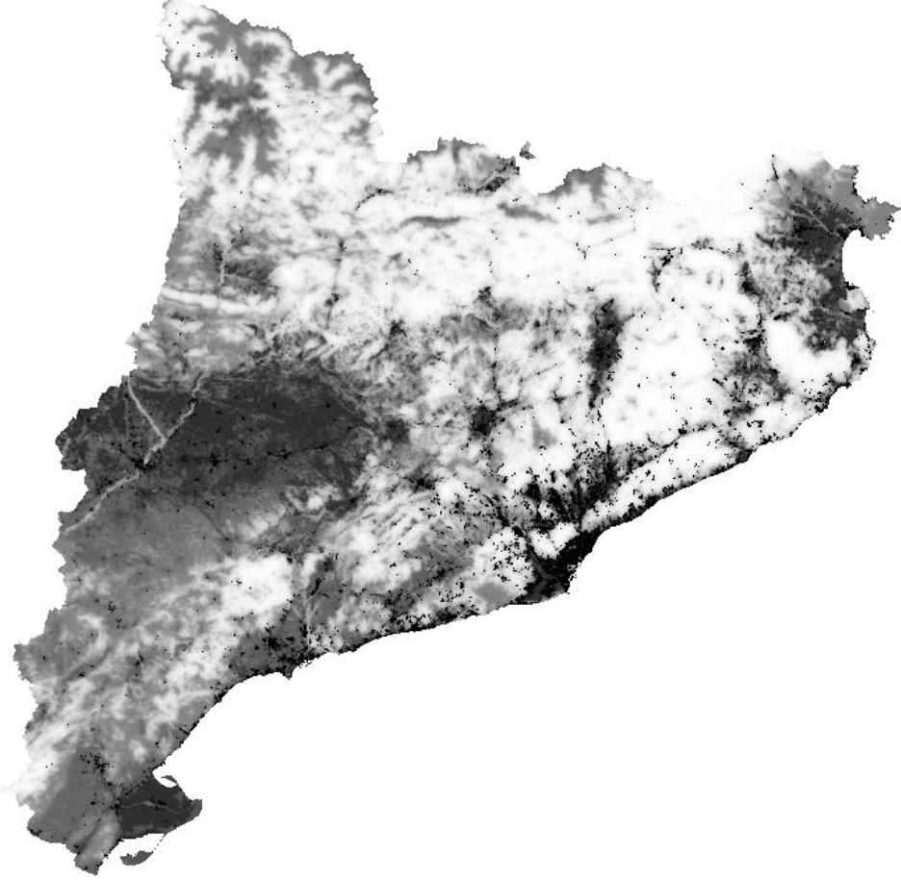
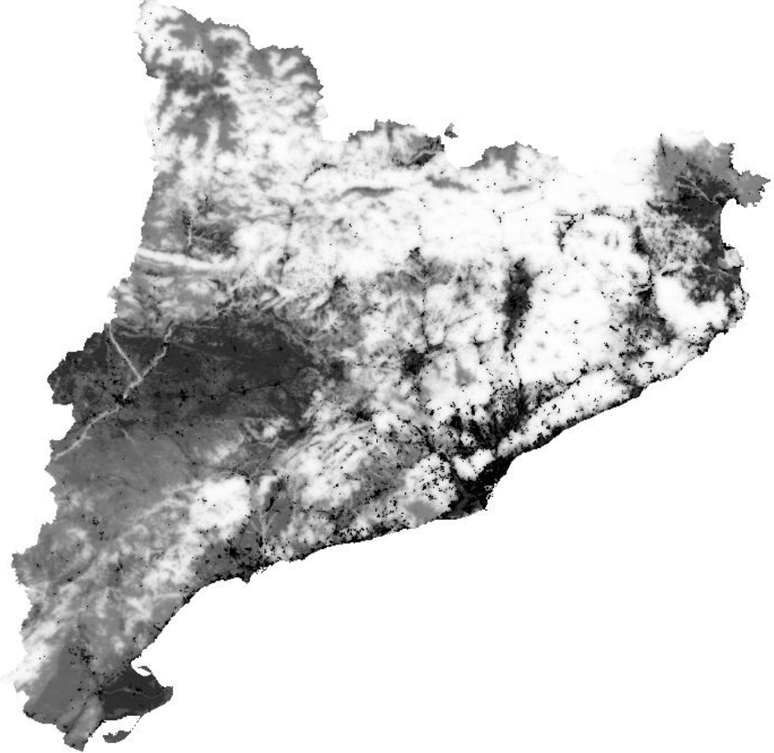
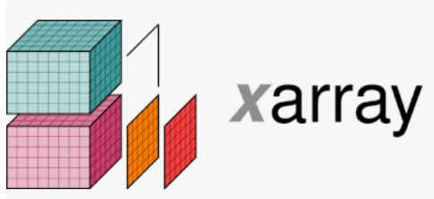
https://callus.ddns.net/cgi-bin/mmdc.py/collections/TerrestrialConnectivityIndex/coverage? subset=E(260000:528000),N(4488000:4748000),time('2017-01-01')& subset-crs=[EPSG:32631]&crs=[EPSG:32631]& properties=Forest-Slice(Forest,['time'],['2012-01-01'])&scale-factor=0.5
OGC API Coverages
https://github.com/AD4GD/Component-OAPI_CoveragesForODC

Slide 13
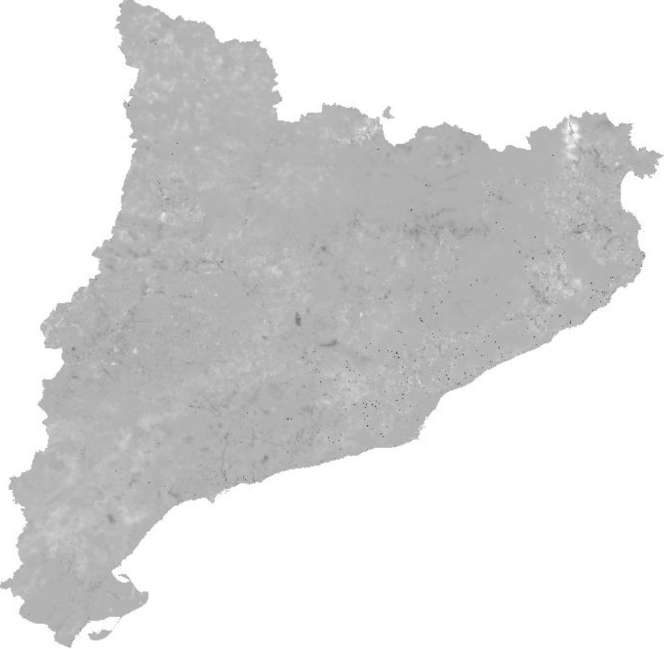
https://callus.ddns.net/cgi-bin/mmdc.py/collections/TerrestrialConnectivityIndex/coverage?subset=E(260000:528000),N(4488000:4748000),time('2017-01-01')&subset-crs=[EPSG:32631]&crs=[EPSG:32631]&properties=Forest-Slice(Forest,['time'],['2012-01-01'])&scale-factor=0.5
https://github.com/AD4GD/Component-OAPI_CoveragesForODC

Slide 14
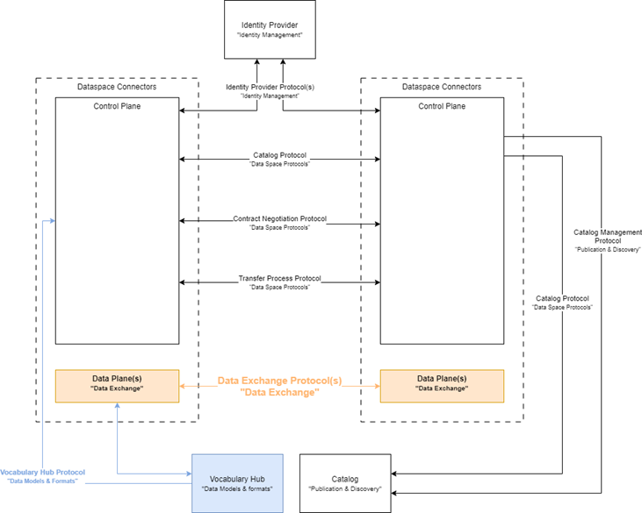
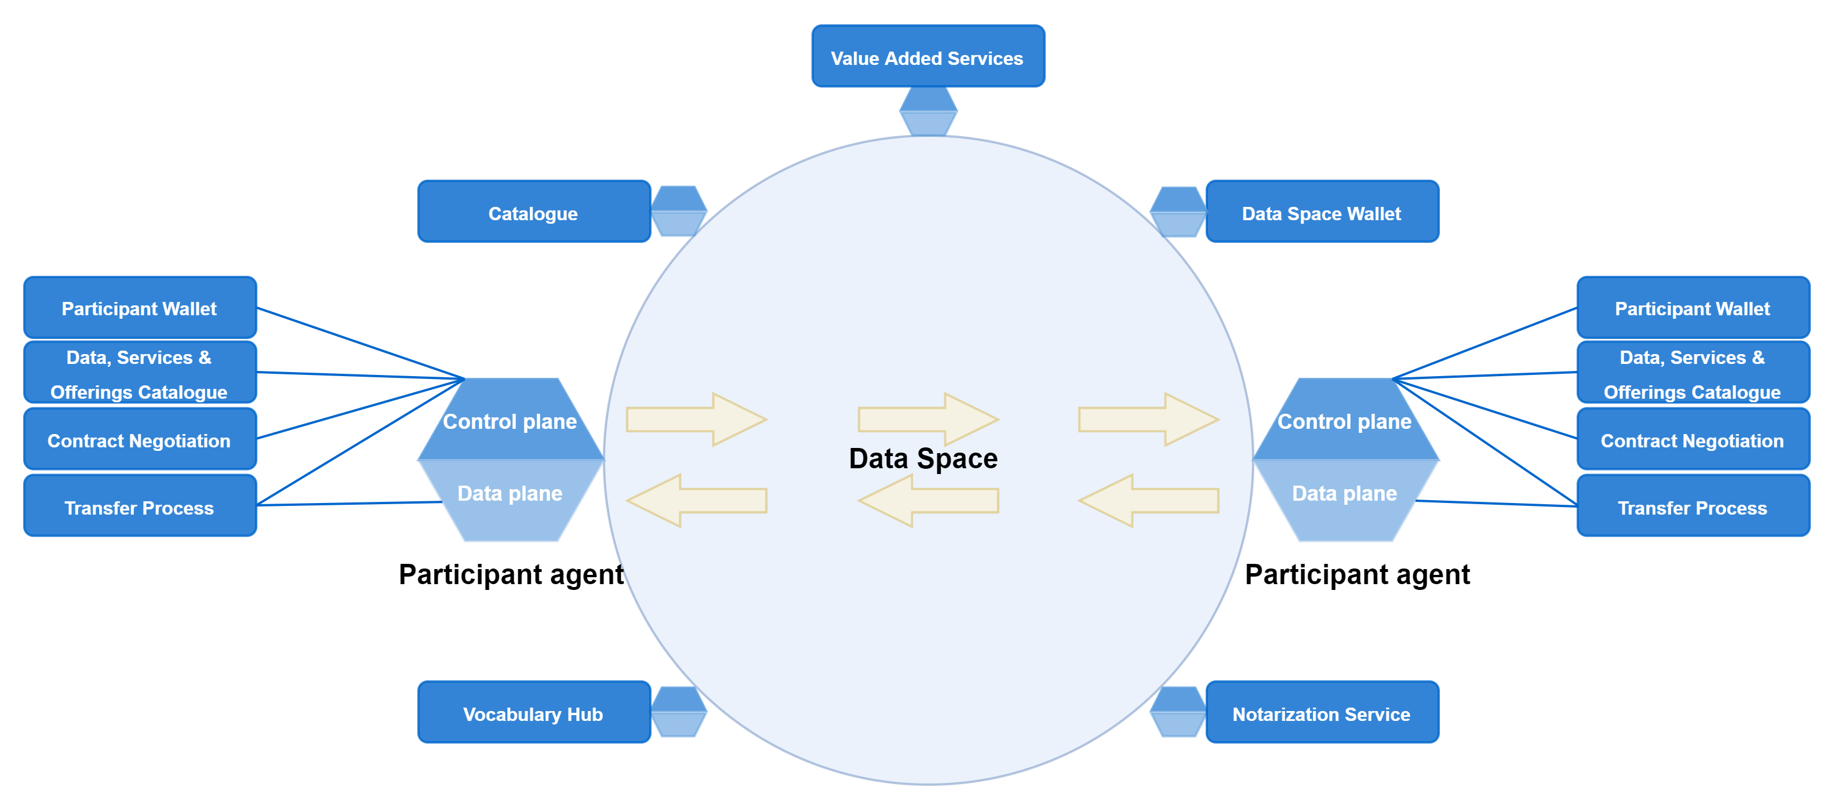
Data space new component (connector)
Connector validates contracts between trusted parties
APIs
STAplus OAPI Cov.
Rainbow

Slide 15
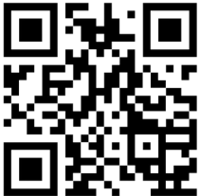
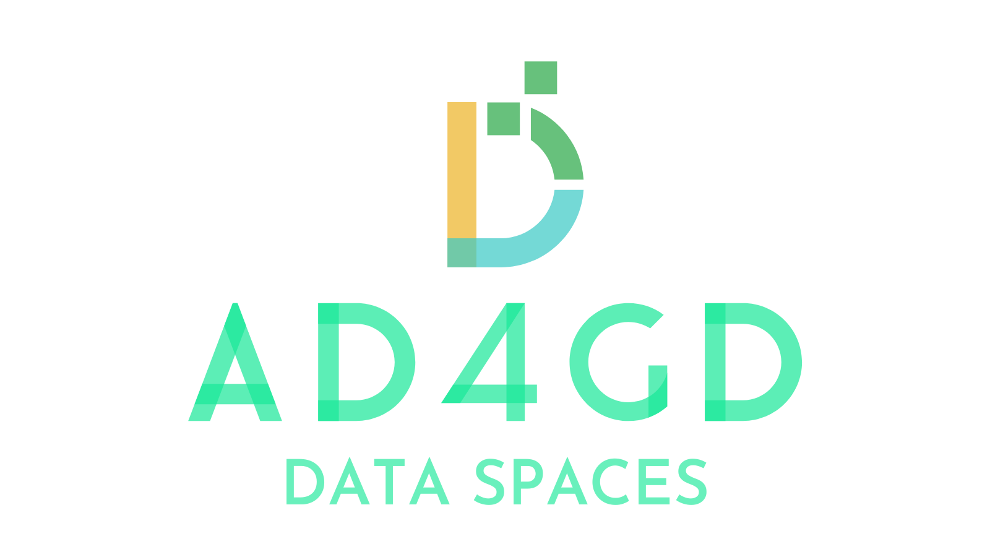
Thank you!
https://actiongroup.greendealdata.space/
Action Group on the Green Deal Data Space
Get our newsletter!
www.ad4gd.eu
Twitter: @ad4gd_project
LinkedIn: AD4GD Project
15
eepurl.com/iz6mDY

